Slide 1
Arduino Workshop #7
The SPI Bus – Digital Potentiometer
Notes:
24 - Arduino Uno
24 - USB cables
24 - Red LED
24 - Yellow LED
24 - Green LED
24 - Blue LED
96 - 100 Ω resistors
24 - Speakers
24 - Jumper wire sets
24 - Breadboards
48 - MCP4231 Digital SPI potentiometer IC

Slide 2
PowerPoint and Code
Github.com/EELabMan
Go To Repositories and find Arduino 7 SPI bus

Slide 3
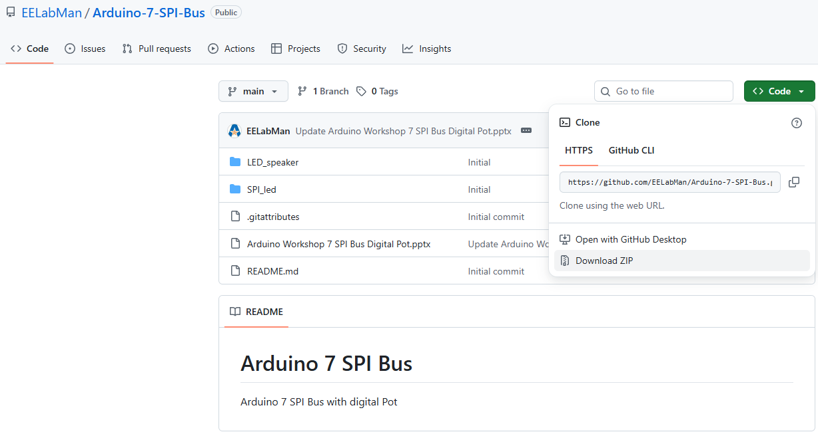
PowerPoint and Code
Click the GREEN code button and download the ZIP folder. BE SURE TO UNZIP THIS FOLDER.

Slide 4
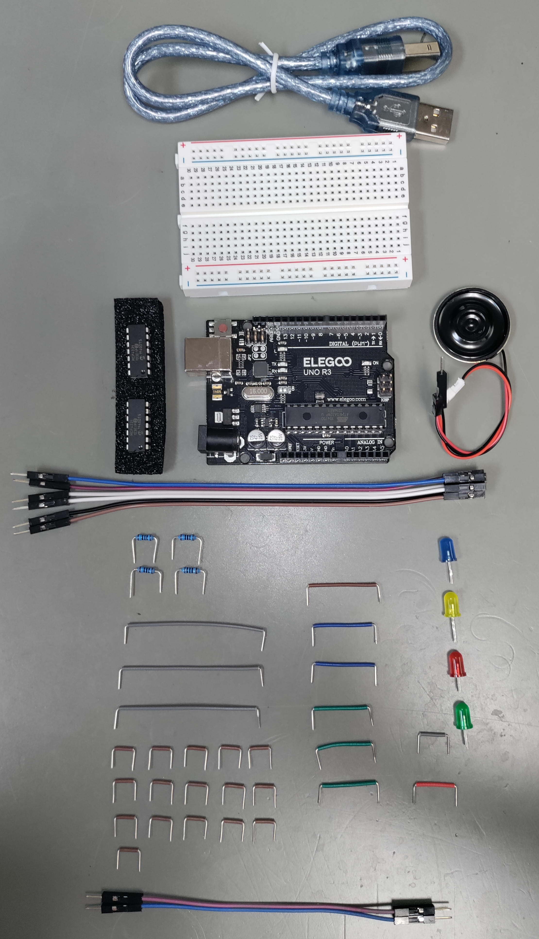
Parts
USB Cable
Breadboard
Arduino Uno
Speaker
2x MCP4231
Blue LED
Yellow LED
6x 150mm Jumpers
Red LED
4x 100 Ω resistors
Green LED
3x 125mm Gray
Breadboard wires
1x gray small BB wire
1x orange small BB wire
1x brown 2x blue 3 green
BB wire
16x 10mm Brown
Breadboard wires
2x 100mm Jumpers

Slide 5
The SPI Bus
SPI : Serial Peripheral Interface
Originally created by Motorola
Full-duplex communications standard
Enables simultaneous bi-directional communication
Between a Controller and one (or more) peripherals.
No formal protocol
Some devices operate slightly different
Number of bits
Chip Select (CS) line
Other minor things

Slide 6
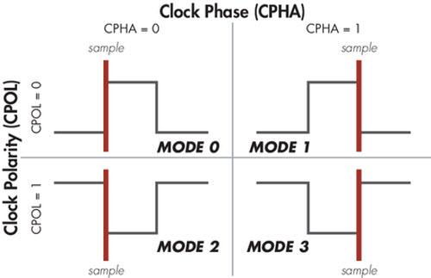
SPI can act in 4 main ways
SPI devices are synchronous (SCLK)
Data transmitted is in sync with the clock
Data is shifted into the device on the rising or falling clock edge of the clock signal (clock phase)
Default state can be set either high or low (called the clock polarity)
SPI Mode | Clock Polarity | Clock Phase
Mode 0 | Low Idle | Data Captured on rising edge
Mode 1 | Low Idle | Data Captured on falling edge
Mode 2 | High Idle | Data Captured on falling edge
Mode 3 | High Idle | Data Captured on rising edge

Slide 7
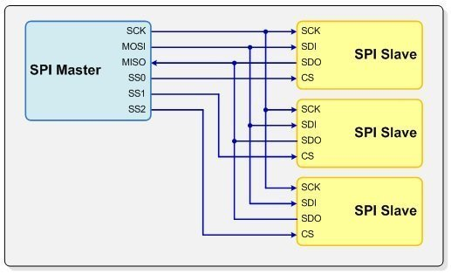
SPI hardware and communications design
The SPI system set up is relatively simple.
Three pins are used for communication
Serial Clock (SCLK)
Serial Data In and Serial Data Out ( SDI & SDO ) on all SPI chips and microcontroller
Older terms still used
Master Out Slave IN (MOSI)
Master In Slave Out (MISO)
Each device has an additional Chip Select (CS) pin
Older term is Slave Select (SS)
Total number of pins is 3 + n
n is the number of SPI devices

Slide 8
Notice
Unlike I²C bus
pull up resistors are not required
Communication is bidirectional
To wire an SPI device to the Arduino you simply need to connect the MOSI,MISO,SCLK, and SS pins
Because SPI is not a universal standard, manufacture may refer to lines differently
Slave select may be called chip select (CS)
Serial clock could be called just clock (CLK)
MISO and MOSI are sometimes abbreviated to serial data in (SDI) and serial data out (SDO)

Slide 9
Communication scheme
Basic process is as follows
Set Chip Select pin low (for the device you want to communicate with)
Toggle the clock line up and down at a speed less than or equal to the transmission speed supported by the device
For each clock cycle, send 1 bit on the MOSI line, and receive 1 bit on the MISO line
Continue until transmitting (or receiving) is done, and stop toggling the clock line
Return Chip Select pin to high state
Note:
Every clock cycle a bit must be sent and received, but that bit does not necessarily need to mean anything (we will use this fact later… it will be more clear then)

Slide 10
SPI vs I²C
SPI Advantages | I²C advantages
Can operate at higher speed | Requires only two communication lines
Generally easier to work with | Built in Arduino Hardware support
No pull up resistors needed
Built in Arduino support

Slide 11
Gathering Info from data sheets
Data sheets will usually answer the following questions
What is the pin-out of the IC and which pins are the control pins?
What is the resistance of the potentiometer in my chip?
Which SPI command must be sent to control the two digital wipers?

Slide 12
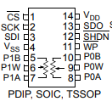
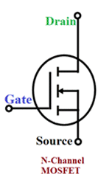
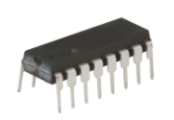
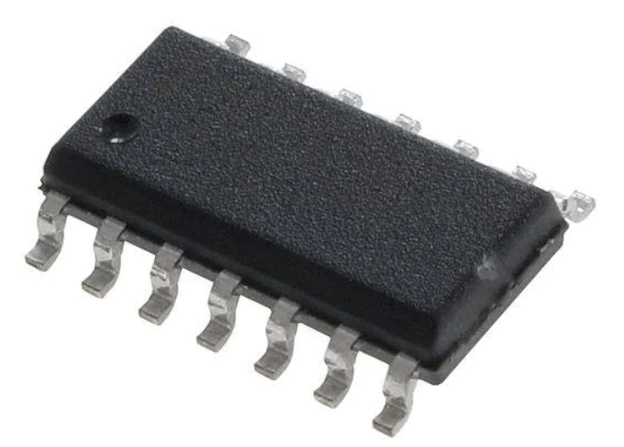
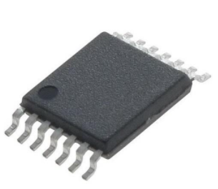
MCP4231 – Digital Potentiometer Pin-Out Diagram
P0A,P0W,P0B - 1st digitally controlled POT
P1A,P1W,P1B - 2nd digitally controlled POT
VDD - 5 V power ( Drain )
VSS – ground ( Source )
CS – Chip Select (bar above indicates its active low)
SDI, SDO - MOSI and MISO respectively
SCK – Serial Clock
SHDN, WP - shutdown and wipe protect (WP is not connected, SHDN should be connected to 5 V)
IC’s come in different packages:
Plastic Dual inline package
Small Outline IC
Thin Shrink Small Outline Package
Notes:
Vcc:
Stands for "Collector Voltage." In BJT circuits, the collector is the terminal where current flows out of the transistor. Vcc is the voltage source connected to the collector, providing power to the transistor and other components in the circuit.
Vdd:
Stands for "Drain Voltage." In MOSFETs, the drain is the terminal where current flows into the transistor. Vdd is the voltage source connected to the drain, supplying power to the MOSFET and potentially other parts of the circuit.

Slide 13
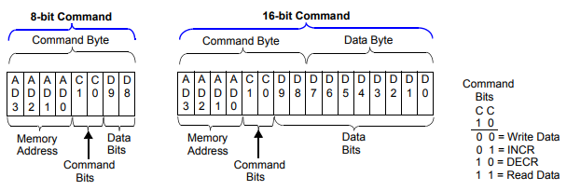
Understanding SPI commands you need to send
We see two command types
8 bit
Allows increment of potentiometer with single byte
16 bit
Allows to set state of POT arbitrarily
We will use 16 bit
It also indicates
POT 0 is address 0
To write to POT 0 you transmit 00000000
Followed by the value (0 to 128)
POT 1 is address 1
To write to POT 1 you transmit 00010000
Followed by the value (0 to 128)

Slide 14
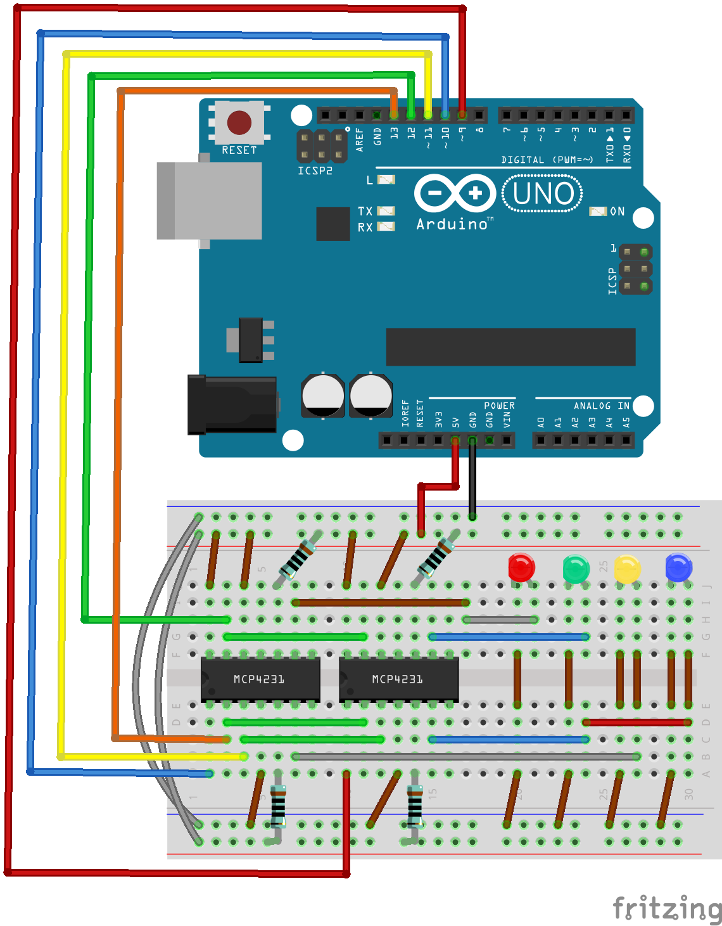
Let's wire up a project
Resistors are 100Ω
Power to pins 12 and 14 each chip
Wire the Arduino up last to avoid too many wires in your way while building the breadboard.

Slide 15
How the project will work
When the wiper for the potentiometer is turned to minimum
Current flows from the 5 V rail through
The 100 Ω resistor
The wiper (~ 75 Ω)
Then the LED
The wiper for the POT is turned to maximum
Current flows from the 5 V rail through
The 100 Ω resistor
The entire potential of the POT (10 ㏀)
The wiper (~ 75 Ω)
Then the LED
Even when the POT is low, the minimum resistance in series to the LED is 175 Ω (enough to safely current limit it)
As the “digiPOT” is changed the brightness will change
This method of control is useful if you have exhausted all your PWM pins

Slide 16
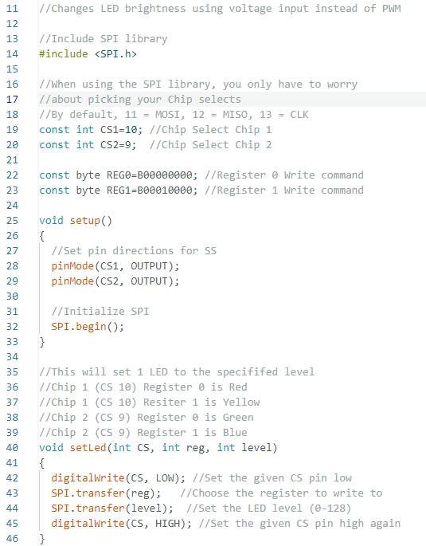
The code
Include the SPI.h library (Line 14) and initialize it in the setup function (Line 32).
Declare two constant integers for the two chip selects. (Line 19-20)
Declare two constant bytes for each of the registers in the chips. ( Line 22-23)
setLed function does the following
Bring the CS pin for the chip low
Send the appropriate register/command byte to the chosen the digiPOT
Send the value between 0 and 128
Bring the CS pin for the chip High

Slide 17
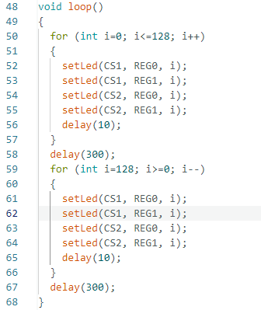
The code
Main Loop
The first for loop sends the values 0 to 128 sequentially to Chip 1 pot 1, the Chip 1 pot 2, then Chip 2 pot 1 and lastly Chip 2 pot 2.
The second loop sends the value 128 to 0 sequentially to Chip 1 pot 1, the Chip 1 pot 2, then Chip 2 pot 1 and lastly Chip 2 pot 2.
Upload SPI_led.ino to the Arduino

Slide 18
New Commands and what they do
#include <SPI.h>
Allows you to include the SPI library from the Arduino libraries in your sketch
SPI.begin()
Enable you to initialize the SPI interface on the hardware SPI pins for the Arduino
SPI.transfer()
Sends data over the SPI BUS
Connection assignments
CS for chip 1 is connected to pin 10
CS for chip 2 is connected to pin 9
The byte registry is determined from the data sheet (as mentioned earlier)
“B” in front of a string of 1s and 0s creates a byte variable
Tells the Arduino it is a binary format
setLED()
Accepts and CS pin number , a register byte, and a POT setting
Transmits data to appropriate chip

Slide 19

Let’s do something a bit harder
We could control LED brightness with The PWM.
Something we can’t do with a PWM… Control The volume of a tone
We will use the SPI digiPOT to control the volume of a speaker dynamically

Slide 20
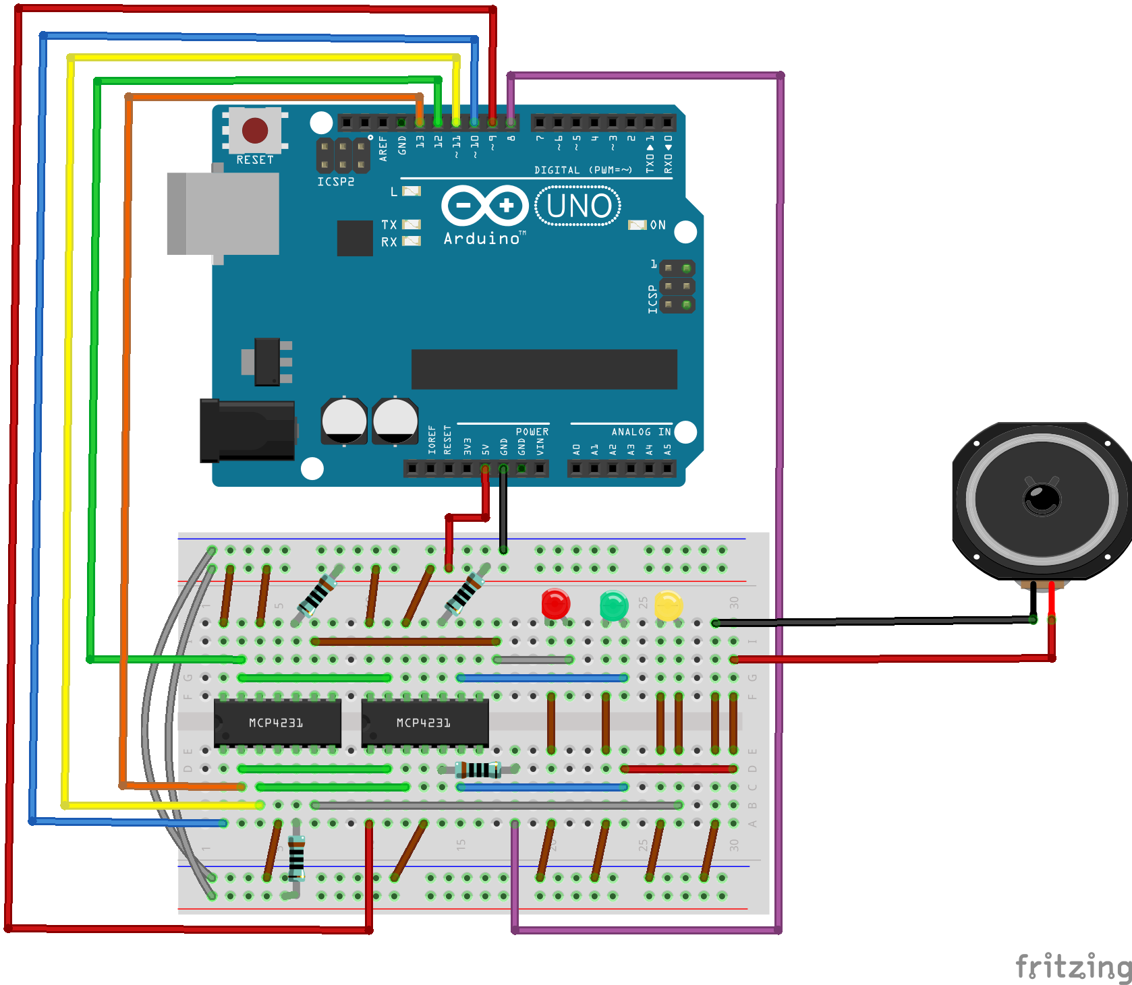
Wire it up
Change the resistor location on the second Chip pin 5 like shown.
Remove the blue LED and insert the speaker as shown.
Upload LED_Speaker.ino to the arduino

Slide 21
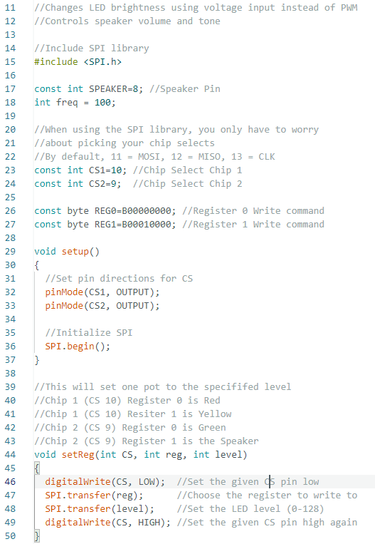
The code
Slight change to the code.
Set constant integer speaker to pin 8. (17)
Initialize integer frequency to 100. (18)

Slide 22
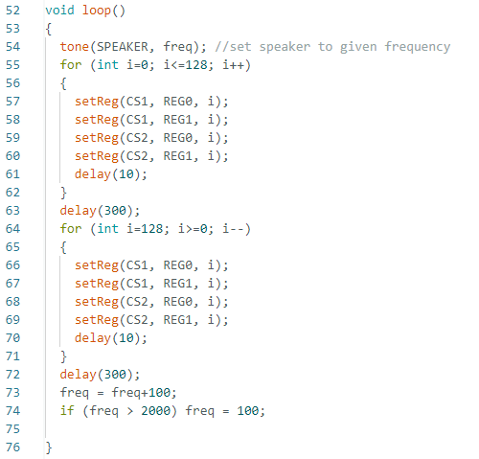
The code (cont.)
Slight change to the code.
Set constant integer speaker to pin 8. (17)
Initialize integer frequency to 100. (18)
Set a tone on speaker pin 8. (54)
For loop 1: Volume of tone will start loud and soften
For loop 2: Volume will start soft and louden.
Frequency jumps by 100 Hertz and the whole process starts again until frequency hits 1900 hertz.

Slide 23
What should happen
Lights should change intensity
Speaker will change volume
On each cycle it will increase in frequency from 100 Hz to 2000 Hz

Slide 24
Stay tuned
Arduino 8 will cover how to use a Liquid Crystal Display or LCD.
We’ll hook one up and program it to display information! We’ll also make an automatic cooling system!

